Slide 1
UNIT-1 Introduction
RELATIONAL DATABASE MANAGEMENT SYSTEM(RDBMS)
MCA210 – II Semester
Prof C S Santhosh
Assistant Professor
Department of Computer Applications
JSS Science and Technology University, Mysuru
Email – sancs84@jssstuniv.in , sancs84@sjce.ac.in

Slide 2
Course Outcomes
CO-1 : Master the basic concepts of data models, modeling notations and have a broad understanding of database concepts and database management system software.
CO-2 : Explore the relation with Algebraic expressions, operations, transactions in Relational Database Systems.
CO-3 : Model an application’s data requirements using conceptual modeling tools like ER-diagrams and design database schemas based on the conceptual model.
CO-4: Write SQL commands to create tables and indexes in a relational DBMS and to design the queries to handle all the operations of RDBMS on an application.
CO-5: Design and build a simple database system and demonstrate the competence with the fundamental tasks involved with Modeling, Design and Implementing a RDBMS.

Slide 3
What is Database?
The database is a collection of inter-related data which is used to retrieve, insert and delete the data efficiently.
It is also used to organize the data in the form of a table, schema, views, and reports, etc.
For example: The college Database organizes the data about the admin, staff, students and faculty etc.
Using the database, you can easily retrieve, insert, and delete the information.

Slide 4
Database Management System:
Database management system is a software which is used to manage the database.
For example: MySQL, Oracle, etc are a very popular commercial database which is used in different applications.
DBMS provides an interface to perform various operations like database creation, storing data in it, updating data, creating a table in the database and a lot more.
It provides protection and security to the database. In the case of multiple users, it also maintains data consistency.

Slide 5
Why to Learn DBMS?
Traditionally, data was organized in file formats. DBMS was a new concept then, and all the research was done to make it overcome the deficiencies in traditional style of data management.
Real-world entity − A modern DBMS is more realistic and uses real-world entities to design its architecture. It uses the behavior and attributes too
Relation-based tables − DBMS allows entities and relations among them to form tables.
Isolation of data and application − A database system is entirely different than its data. A database is an active entity, whereas data is said to be passive, on which the database works and organizes. DBMS also stores metadata, which is data about data, to ease its own process.
Less redundancy − DBMS follows the rules of normalization, which splits a relation when any of its attributes is having redundancy in values.
Consistency − Consistency is a state where every relation in a database remains consistent. There exist methods and techniques, which can detect attempt of leaving database in inconsistent state.
Query Language − DBMS is equipped with query language, which makes it more efficient to retrieve and manipulate data.

Slide 6
DBMS allows users the following tasks:
Data Definition: It is used for creation, modification, and removal of definition that defines the organization of data in the database.
Data Updating: It is used for the insertion, modification, and deletion of the actual data in the database.
Data Retrieval: It is used to retrieve the data from the database which can be used by applications for various purposes.
User Administration: It is used for registering and monitoring users, maintain data integrity, enforcing data security, dealing with concurrency control, monitoring performance and recovering information corrupted by unexpected failure.

Slide 7
Characteristics of DBMS
It uses a digital repository established on a server to store and manage the information.
It can provide a clear and logical view of the process that manipulates data.
DBMS contains automatic backup and recovery procedures.
It contains ACID properties which maintain data in a healthy state in case of failure.
It can reduce the complex relationship between data.
It is used to support manipulation and processing of data.
It is used to provide security of data.
It can view the database from different viewpoints according to the requirements of the user.

Slide 8
Advantages of DBMS
Controls database redundancy: It can control data redundancy because it stores all the data in one single database file and that recorded data is placed in the database.
Data sharing: In DBMS, the authorized users of an organization can share the data among multiple users.
Easily Maintenance: It can be easily maintainable due to the centralized nature of the database system.
Reduce time: It reduces development time and maintenance need.
Backup: It provides backup and recovery subsystems which create automatic backup of data from hardware and software failures and restores the data if required.
multiple user interface: It provides different types of user interfaces like graphical user interfaces, application program interfaces.

Slide 9
Disadvantages of DBMS
Cost of Hardware and Software: It requires a high speed of data processor and large memory size to run DBMS software.
Size: It occupies a large space of disks and large memory to run them efficiently.
Complexity: Database system creates additional complexity and requirements.
Higher impact of failure: Failure is highly impacted the database because in most of the organization, all the data stored in a single database and if the database is damaged due to electric failure or database corruption then the data may be lost forever.

Slide 10
Applications of DBMS
A database management system stores data in such a way that it becomes easier to retrieve, manipulate, and produce information. Following are the important applications of DBMS:
ACID Properties − DBMS follows the concepts of :
Atomicity,
Consistency,
Isolation, and
Durability (normally shortened as ACID).
These concepts are applied on transactions, which manipulate data in a database. ACID properties help the database stay healthy in multi-transactional environments and in case of failure.

Slide 11
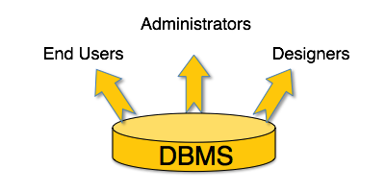
Users:
A typical DBMS has users with different rights and permissions who use it for different purposes. Some users retrieve data and some back it up. The users of a DBMS can be broadly categorized as follows −

Slide 12
Administrators − Administrators maintain the DBMS and are responsible for administrating the database. They are responsible to look after its usage and by whom it should be used. They create access profiles for users and apply limitations to maintain isolation and force security. Administrators also look after DBMS resources like system license, required tools, and other software and hardware related maintenance.
Designers − Designers are the group of people who actually work on the designing part of the database. They keep a close watch on what data should be kept and in what format. They identify and design the whole set of entities, relations, constraints, and views.
End Users − End users are those who actually reap the benefits of having a DBMS. End users can range from simple viewers who pay attention to the logs or market rates to sophisticated users such as business analysts.

Slide 13
What is Data Governance?
Data governance is a collection of processes, roles, policies, standards, and metrics that ensure the effective and efficient use of information in enabling an organization to achieve its goals.
A well-crafted data governance strategy is fundamental for any organization that works with big data, and will explain how your business benefits from consistent, common processes and responsibilities.
For example, if a business driver for your data governance strategy is to ensure the privacy of healthcare-related data, patient data will need to be managed securely as it flows through your business.
NOTE: Data Governance is Not Data Management
Data management refers to the management of the full data lifecycle needs of an organization. Data governance is the core component of data management, tying together nine other disciplines, such as data quality, reference and master data management, data security, database operations, metadata management, and data warehousing.

Slide 14
Benefits of Data Governance
An effective data governance strategy provides many benefits to an organization, including:
A common understanding of data — Data governance provides a consistent view of, and common terminology for, data, while individual business units retain appropriate flexibility.
Improved quality of data — Data governance creates a plan that ensures data accuracy, completeness, and consistency.
Data map.
360-degree view of each customer and other business entities .
Consistent compliance .
Improved data management .

Slide 15
History of Database Software:
Ancient Times: Human beings began to store information very long ago. In the ancient times, elaborate database systems were developed by government offices, libraries, hospitals, and business organizations, and some of the basic principles of these systems are still being used today.
1970 to 1972: E.F. Codd published an important paper to propose the use of a relational database model, and his ideas changed the way people thought about databases. In his model, the database’s schema, or logical organization, is disconnected from physical information storage, and this became the standard principle for database systems.

Slide 16
Early 1990s: After a database industry shakeout, most of the surviving companies sold complex database products at high prices. Around this time, new client tools for application development were released, and these included the Oracle Developer, PowerBuilder, VB, and others. A number of tools for personal productivity, such as ODBC and Excel/Access, were also developed. Prototypes for Object Database Management Systems, or ODBMS, were created in the early 1990s.

Slide 17
First generation
Hierarchical model
Information Management System (IMS)
Network model
Conference on Data System Languages (CODASYL)
Data Base Task Group (DBTG)
Limitation
Complex program for simple query
Minimum data independence
No theoretical foundation
Second generation
Relational model
E. R. Codd
DB2, Oracle
Limitation
Limited data modeling
Third generation
Object-relational DBMS
Object-oriented DBMS

Slide 18
DBMS Environment:
Hardware
Client-server architecture
Software
dbms, os, network, application
Data
Schema, subschema, table, attribute
People
Data administrator & database administrator
Database designer: logical & physical
Application programmer
End-user: naive & sophisticated
Procedure
Start, stop, log on, log off, back up, recovery

Slide 19
File Systems vs. Database Systems :
DBMS | File System
DBMS is a collection of data. In DBMS, the user is not required to write the procedures. | File system is a collection of data. In this system, the user has to write the procedures for managing the database.
DBMS gives an abstract view of data that hides the details. | File system provides the detail of the data representation and storage of data.
DBMS provides a crash recovery mechanism, i.e., DBMS protects the user from the system failure. | File system doesn't have a crash mechanism, i.e., if the system crashes while entering some data, then the content of the file will lost.
DBMS provides a good protection mechanism. | It is very difficult to protect a file under the file system.
DBMS contains a wide variety of sophisticated techniques to store and retrieve the data. | File system can't efficiently store and retrieve the data.
DBMS takes care of Concurrent access of data using some form of locking. | In the File system, concurrent access has many problems like redirecting the file while other deleting some information or updating some information.

Slide 20
Main Features of a DBMS
Some of the significant features of a DBMS include:
Low Repetition and Redundancy
Easy Maintenance of Large Databases
Enhanced Security
Improved File Consistency
Multi-User Environment Support
As a database is typically accessed by multiple operators simultaneously, these operators may need different database views. For example, operator A may want to print a bank statement, whereas Operator B would want to only check the bank balance. Although both are querying the same database, they will be presented with different views.

Slide 21
Advantages of using an Enterprise Database:
Easy Access to Company Data
Reporting and Planning Capabilities
More Secure and Quality Data
Other advantages of enterprise resource planning systems include scalability, customization and potential cost savings.
What Are Some Benefits and Challenges of Enterprise Systems?
Better Productivity and Flexibility
Easier Business Planning
Improved Record Keeping and Compliance(the action or fact of complying with a wish or command)
Cost Challenges of Enterprise Systems
Additional Work for Implementation
Data Loss and Downtime Risk

Slide 22
Popular DBMS Software
Here, is the list of some popular DBMS system:
MySQL
Microsoft Access
Oracle
PostgreSQL
dBASE
FoxPro
SQLite
IBM DB2
LibreOffice Base
MariaDB
Microsoft SQL Server etc.

Slide 23
Application of DBMS
Sector | Use of DBMS
Banking | For customer information, account activities, payments, deposits, loans, etc.
Airlines | For reservations and schedule information.
Universities | For student information, course registrations, colleges and grades.
Telecommunication | It helps to keep call records, monthly bills, maintaining balances, etc.
Finance | For storing information about stock, sales, and purchases of financial instruments like stocks and bonds.
Sales | Use for storing customer, product & sales information.
Manufacturing | It is used for the management of supply chain and for tracking production of items. Inventories status in warehouses.
HR Management | For information about employees, salaries, payroll, deduction, generation of paychecks, etc.

Slide 24

Types of DBMS
Four Types of DBMS systems are:
Hierarchical database
Network database
Relational database
Object-Oriented database

Slide 25
Hierarchical DBMS
In a Hierarchical database, model data is organized in a tree-like structure. Data is Stored Hierarchically (top down or bottom up) format. Data is represented using a parent-child relationship. In Hierarchical DBMS parent may have many children, but children have only one parent.
Network Model
The network database model allows each child to have multiple parents. It helps you to address the need to model more complex relationships like as the orders/parts many-to-many relationship. In this model, entities are organized in a graph which can be accessed through several paths.
Relational model
Relational DBMS is the most widely used DBMS model because it is one of the easiest. This model is based on normalizing data in the rows and columns of the tables. Relational model stored in fixed structures and manipulated using SQL.
Object-Oriented Model
In Object-oriented Model data stored in the form of objects. The structure which is called classes which display data within it. It defines a database as a collection of objects which stores both data members values and operations.

Slide 26
DBMS Architecture
The DBMS design depends upon its architecture.
The basic client/server architecture is used to deal with a large number of PCs, web servers, database servers and other components that are connected with networks.
The client/server architecture consists of many PCs and a workstation which are connected via the network.
DBMS architecture depends upon how users are connected to the database to get their request done.
Types of DBMS Architecture
There are three types of DBMS architecture:
1. Single tier architecture 2. Two tier architecture 3. Three tier architecture

Slide 27
1-Tier Architecture
In this architecture, the database is directly available to the user. It means the user can directly sit on the DBMS and uses it.
Any changes done here will directly be done on the database itself. It doesn't provide a handy tool for end users.
The 1-Tier architecture is used for development of the local application, where programmers can directly communicate with the database for the quick response.
Database designers and programmers normally prefer to use single-tier architecture.
In this type of architecture, the database is readily available on the client machine, any request made by client doesn’t require a network connection to perform the action on the database.

Slide 28
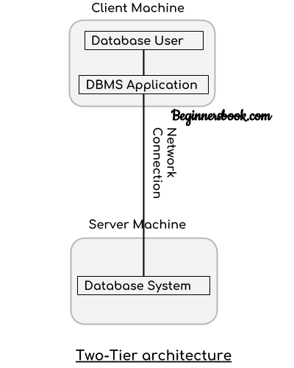
2-Tier Architecture

Slide 29
In two-tier architecture, the Database system is present at the server machine and the DBMS application is present at the client machine, these two machines are connected with each other through a reliable network as shown in the diagram.
Whenever client machine makes a request to access the database present at server using a query language like sql, the server perform the request on the database and returns the result back to the client. The application connection interface such as JDBC, ODBC are used for the interaction between server and client.

Slide 30

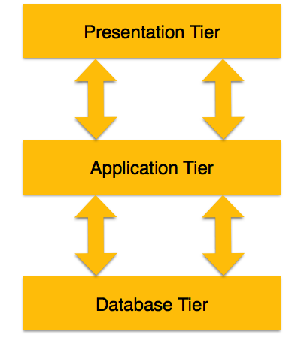
3-Tier Architecture

Slide 31
A 3-tier architecture separates its tiers from each other based on the complexity of the users and how they use the data present in the database. It is the most widely used architecture to design a DBMS.
Database (Data) Tier − At this tier, the database resides along with its query processing languages. We also have the relations that define the data and their constraints at this level.
Application (Middle) Tier − At this tier reside the application server and the programs that access the database. For a user, this application tier presents an abstracted view of the database. End-users are unaware of any existence of the database beyond the application. At the other end, the database tier is not aware of any other user beyond the application tier. Hence, the application layer sits in the middle and acts as a mediator between the end-user and the database.
User (Presentation) Tier − End-users operate on this tier and they know nothing about any existence of the database beyond this layer. At this layer, multiple views of the database can be provided by the application. All views are generated by applications that reside in the application tier.

Slide 32
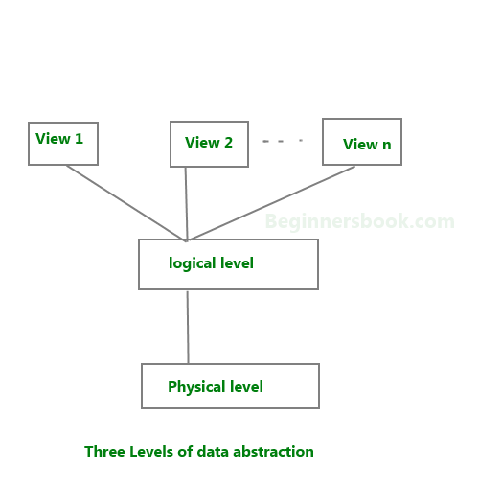
Data Abstraction
Database systems are made-up of complex data structures. To ease the user interaction with database, the developers hide internal irrelevant details from users. This process of hiding irrelevant details from user is called data abstraction.

Slide 33
Physical level: This is the lowest level of data abstraction. It describes how data is actually stored in database. You can get the complex data structure details at this level.
Logical level: This is the middle level of 3-level data abstraction architecture. It describes what data is stored in database.
View level: Highest level of data abstraction. This level describes the user interaction with database system.
Example: Let’s say we are storing customer information in a customer table.
At physical level these records can be described as blocks of storage (bytes, gigabytes, terabytes etc.) in memory. These details are often hidden from the programmers.
At the logical level these records can be described as fields and attributes along with their data types, their relationship among each other can be logically implemented. The programmers generally work at this level because they are aware of such things about database systems.
At view level, user just interact with system with the help of GUI and enter the details at the screen, they are not aware of how the data is stored and what data is stored; such details are hidden from them.

Slide 34
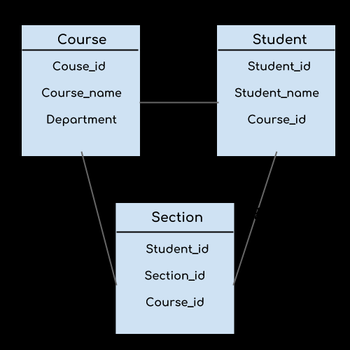
DBMS Schema
Design of a database is called the schema. Schema is of three types: Physical schema, logical schema and view schema.

Slide 35
The design of a database at physical level is called physical schema, how the data stored in blocks of storage is described at this level.
Design of database at logical level is called logical schema, programmers and database administrators work at this level, at this level data can be described as certain types of data records gets stored in data structures, however the internal details such as implementation of data structure is hidden at this level.
Design of database at view level is called view schema.
This generally describes end user interaction with databasesystems.

Slide 36
DBMS Instance
The data stored in database at a particular moment of time is called instance of database.
Database schema defines the variable declarations in tables that belong to a particular database; the value of these variables at a moment of time is called the instance of that database.
For example, lets say we have a single table student in the database, today the table has 100 records, so today the instance of the database has 100 records. Lets say we are going to add another 100 records in this table by tomorrow so the instance of database tomorrow will have 200 records in table. In short, at a particular moment the data stored in database is called the instance, that changes over time when we add or delete data from the database.

Slide 37
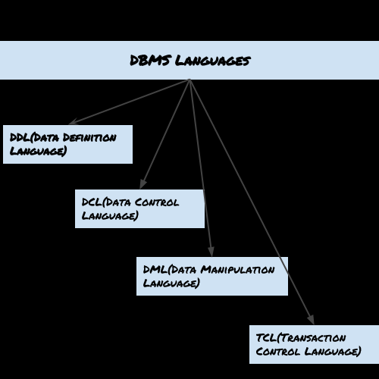
DBMS Languages
Database languages are used to read, update and store data in a database. There are several such languages that can be used for this purpose; one of them is SQL (Structured Query Language).
Types of DBMS languages:
DDL.
DCL.
DML.
TCL.

Slide 38
Data Definition Language (DDL)
DDL is used for specifying the database schema. It is used for creating tables, schema, indexes, constraints etc. in database. Lets see the operations that we can perform on database using DDL:
To create the database instance – CREATE
To alter the structure of database – ALTER
To drop database instances – DROP
To delete tables in a database instance – TRUNCATE
To rename database instances – RENAME
To drop objects from database such as tables – DROP
To Comment – COMMENT
All of these commands either defines or update the database schema that’s why they come under Data Definition language.

Slide 39
Data Manipulation Language (DML)
DML is used for accessing and manipulating data in a database. The following operations on database comes under DML:
To read records from table(s) – SELECT
To insert record(s) into the table(s) – INSERT
Update the data in table(s) – UPDATE
Delete all the records from the table – DELETE

Slide 40
Data Control language (DCL)
DCL is used for granting and revoking user access on a database –
To grant access to user – GRANT
To revoke access from user – REVOKE
In practical data definition language, data manipulation language and data control languages are not separate language, rather they are the parts of a single database language such as SQL.

Slide 41
Transaction Control Language(TCL)
The changes in the database that we made using DML commands are either performed or roll backed using TCL.
To persist the changes made by DML commands in database – COMMIT
To rollback the changes made to the database – ROLLBACK

Slide 42
Data Independence
Data Independence is defined as a property of DBMS that helps you to change the Database schema at one level of a database system without requiring to change the schema at the next higher level. Data independence helps you to keep data separated from all programs that make use of it.
A database system normally contains a lot of data in addition to users’ data. For example, it stores data about data, known as metadata, to locate and retrieve data easily. It is rather difficult to modify or update a set of metadata once it is stored in the database. But as a DBMS expands, it needs to change over time to satisfy the requirements of the users. If the entire data is dependent, it would become a tedious and highly complex job.

Slide 43
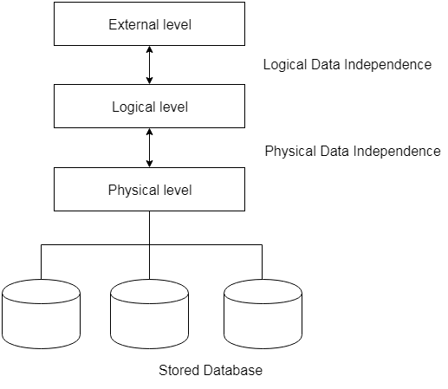
Data Independence
Data independence can be explained using the three-schema architecture.
Data independence refers characteristic of being able to modify the schema at one level of the database system without altering the schema at the next higher level.

Slide 44
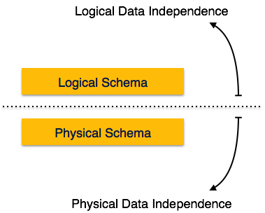
Logical data is data about database, that is, it stores information about how data is managed inside. For example, a table (relation) stored in the database and all its constraints, applied on that relation.
Physical data independence is the power to change the physical data without impacting the schema or logical data.For example, in case we want to change or upgrade the storage system itself − suppose we want to replace hard-disks with SSD − it should not have any impact on the logical data or schemas.

Slide 45
Examples of changes under Physical Data Independence
Due to Physical independence, any of the below change will not affect the conceptual layer.
Using a new storage device like Hard Drive or Magnetic Tapes
Modifying the file organization technique in the Database
Switching to different data structures.
Changing the access method.
Modifying indexes.
Changes to compression techniques or hashing algorithms.
Change of Location of Database from say C drive to D Drive
Examples of changes under Logical Data Independence
Due to Logical independence, any of the below change will not affect the external layer.
Add/Modify/Delete a new attribute, entity or relationship is possible without a rewrite of existing application programs
Merging two records into one
Breaking an existing record into two or more records

Slide 46
Difference between Physical and Logical Data Independence
Logical Data Independence | Physical Data Independence
Logical Data Independence is mainly concerned with the structure or changing the data definition. | Mainly concerned with the storage of the data.
It is difficult as the retrieving of data is mainly dependent on the logical structure of data. | It is easy to retrieve.
Compared to Logic Physical independence it is difficult to achieve logical data independence. | Compared to Logical Independence it is easy to achieve physical data independence.
You need to make changes in the Application program if new fields are added or deleted from the database. | A change in the physical level usually does not need change at the Application program level.
Modification at the logical levels is significant whenever the logical structures of the database are changed. | Modifications made at the internal levels may or may not be needed to improve the performance of the structure.
Concerned with conceptual schema | Concerned with internal schema
Example: Add/Modify/Delete a new attribute | Example: change in compression techniques, hashing algorithms, storage devices, etc

Slide 47
Importance of Data Independence
Helps you to improve the quality of the data
Database system maintenance becomes affordable
Enforcement of standards and improvement in database security
You don't need to alter data structure in application programs
Permit developers to focus on the general structure of the Database rather than worrying about the internal implementation
It allows you to improve state which is undamaged or undivided
Database incongruity is vastly reduced.
Easily make modifications in the physical level is needed to improve the performance of the system.

Slide 48
Database Administrator
A Database Administrator (DBA) in Database Management System (DBMS) is an IT professional who works on creating, maintaining, querying, and tuning the database of the organization.
They are also responsible for maintaining data security and integrity.
This role requires the professionals to have good knowledge and experience in the particular RDBMS that the company uses.
Based on the requirements of the company, there are various types of DBAs including:
Administrative DBA: They maintain and run the databases and servers of the organization. They are mainly concerned with the security patches, replication, and backup of data.
Development DBA: They work on developing SQL queries and stored procedures to meet the requirements of the business. They specialize in database development.
Data Architect: They design schemas, build data structures, table indexes, and relationships. They are mainly responsible for building a structure the meets the business requirements in a specific area.
Data Warehouse DBA: They merge data from numerous data sources and store them in a data warehouse.

Slide 49
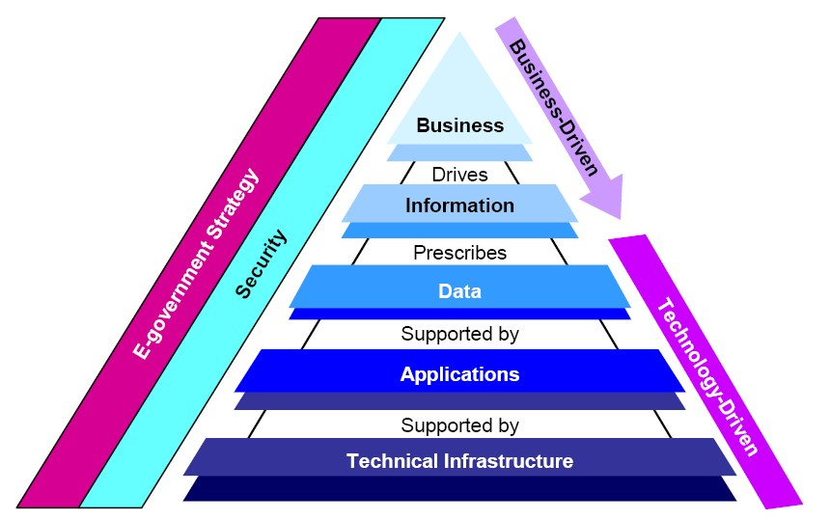
Designing an Enterprise Database System
Enterprise Database design represents a coherent set of corporate policy across a subject area. As corporate policy is executed, data is produced that enables business analysts to research the past, control the present and plan for the future.

Slide 50
Web Databases
A Web database is a database application designed to be managed and accessed through the Internet.
Website operators can manage this collection of data and present analytical results based on the data in the Web database application.
Databases first appeared in the 1990s, and have been an asset for businesses, allowing the collection of seemingly infinite amounts of data from infinite amounts of customers.
Web databases enable collected data to be organized and cataloged thoroughly within hundreds of parameters.
The Web database does not require advanced computer skills, and many database software programs provide an easy "click-and-create" style with no complicated coding.

Slide 51
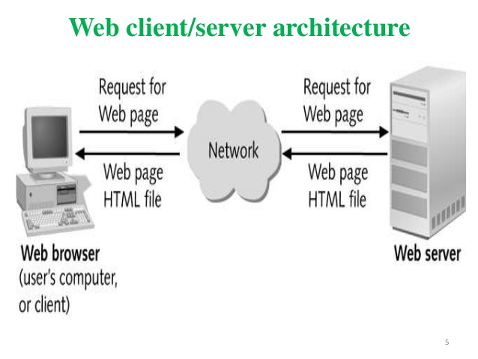

Slide 52
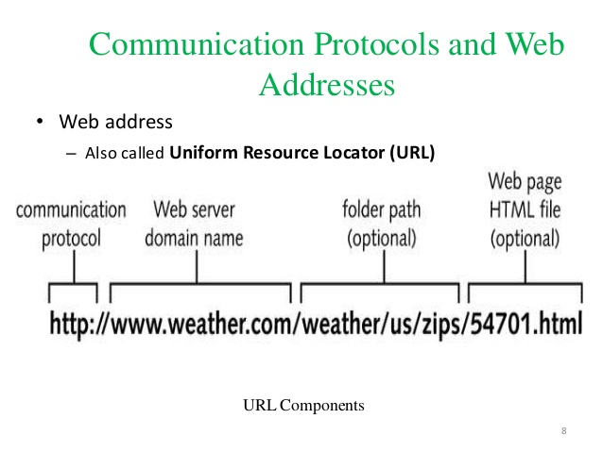

Slide 53
Choosing a DBMS.
Usability
Visualisation & Reporting
Security
Functionality
Support & Development
Integration
Scalability
Cost and Suitability
Hosting
Updates

Slide 54
THANK YOU

